Slide 1

Traffic Advisory Committee
Jaime Rodriguez, Consultant Traffic Engineer
Public Works Department
January 21, 2025

Slide 2
Today’s Topics
Speed Hump Configurations
Current and Future
New State Law (Parking) – AB43 - Daylighting
Implementation and Enforcement
Streetlight Study 2024
Project Findings and Next Steps
Crosswalk Enhancements
Active Projects and Ongoing City Maintenance
CIP Projects
New Projects Starting in 2025
Grant Projects
Safe Streets For All (SS4A) Citywide Traffic Study

Slide 3
Neighborhood Traffic Management Program Flow Chart
STAGE 1
STAGE 2
STAGE 3
Traffic
Calming
Advisory
Committee
Minor
Traffic Calming
Projects
Major
Traffic Calming
Projects
Resident
Request
Data
Collection
Analysis
Data Collection
Analysis
Engineer
Field
Review
Community
Outreach
Community
Outreach
Traffic
Operations
Improvements
RESIDENT
PETITION
TCAC
Budgeting
Design
Community Input
Complete in 6 Months
Monitor for up to 6 Months
SILENT
PETITION

Slide 4
Resident Service Request Summary, 2024
Council District:
1
2
3
4
5
6
7
Service Request Categories:
18
6
7
2
12
Traffic Operations
Traffic Calming
Crosswalk Safety
Traffic Signals/Streetlights
Parking
Service Requests:
13
11
5
8
7
5
7
T.C. Petitions:
1
56 Resident Service
Requests in 2024
Work Orders Generated:
20
3
1
3
1
4
City Public Works
Electrical Contractors
Striping Contractors
Planning
Caltrans
No Action

Slide 5
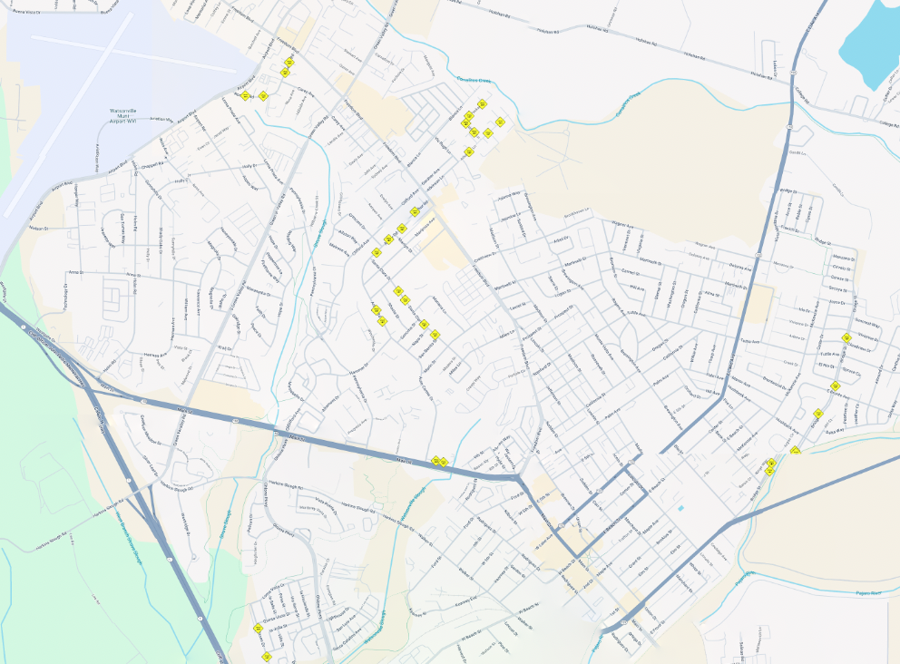


Speed Hump Configurations
Stage 3 Improvements
Speed Hump | Speed Table Locations
31 Ex. Locations in Watsonville
Airport Blvd
Paseo Dr (CD 1)
W Front St (CD 1)
Roache Rd (CD3)
Longview Dr (CD 5)
Arthur Rd (CD 6)
Atkinson Ln (CD 6)
Kadderly Ln (CD 6)
Packard Ln (CD 6)
Santa Clara St (CD 6)
Bridge St (CD 7)
Green Valley Rd
Freedom Blvd
Lake Ave
Main St
Riverside Dr
Ohlone Pkwy

Slide 6
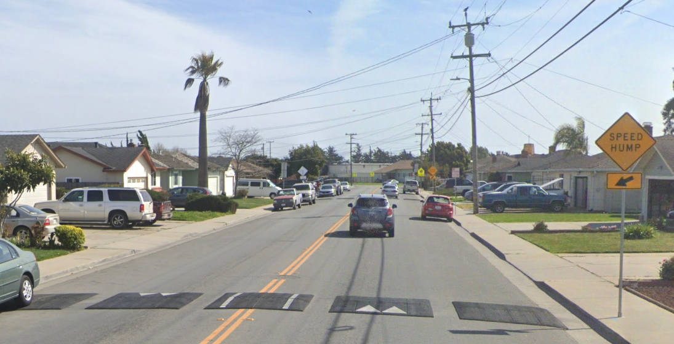
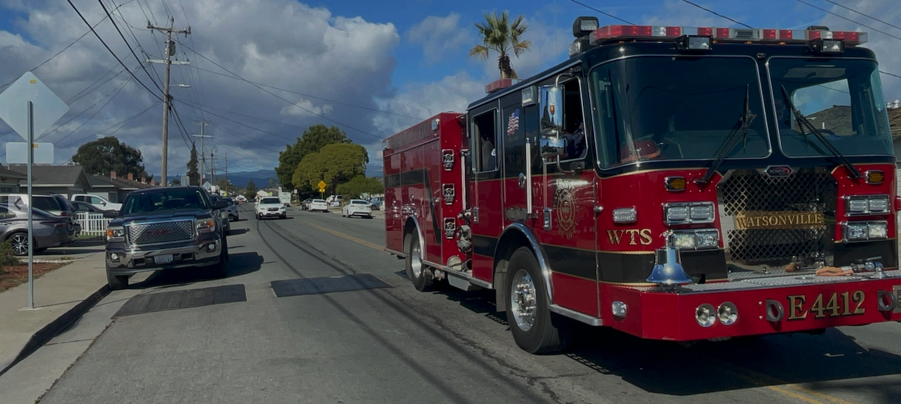
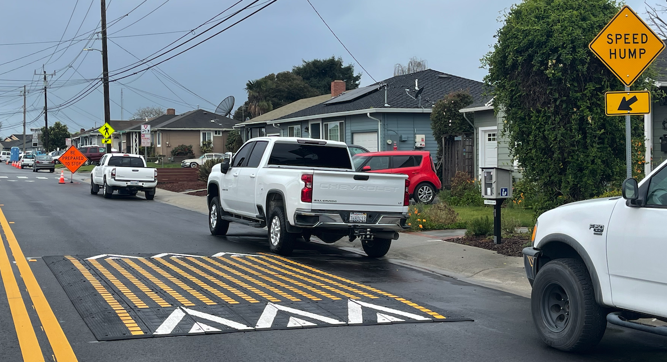
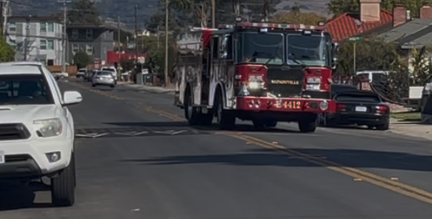
Speed Hump Configurations
Stage 3 Improvements
Speed Hump
Across Entire Roadway
18” Slots
+20 Seconds Travel Time per Hump
Speed Table
Half Street
+5 Seconds Travel Time per Hump

Slide 7
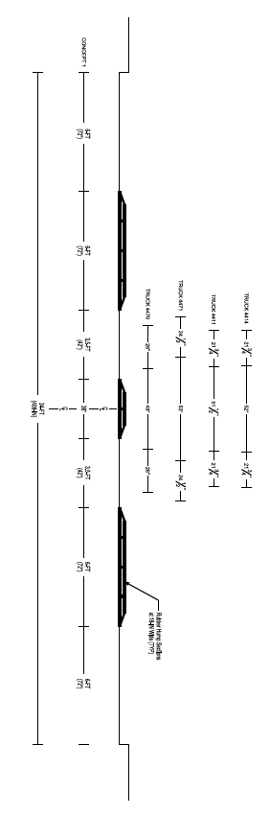
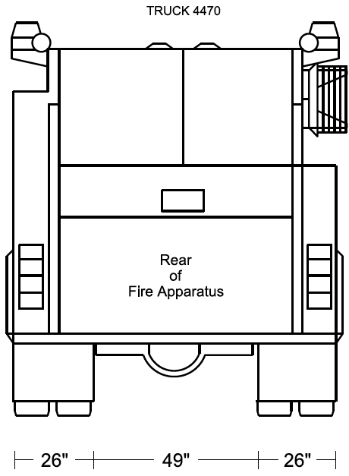
Speed Hump Configurations
Stage 3 Improvements
Any Passenger Vehicle
Could Straddle to Center of Road
To Travel Over Humps
6-FT
6-FT
3.5-FT
3-FT
3.5-FT
6-FT
6-FT

Slide 8
Speed Hump Configurations – Preliminary Recommendations
Stage 3 Improvements
Ex. Speed Hump
Retain for Now
Replace with Future Street Projects
Speed Table
Half Street
- Use for All Future Projects

Slide 9
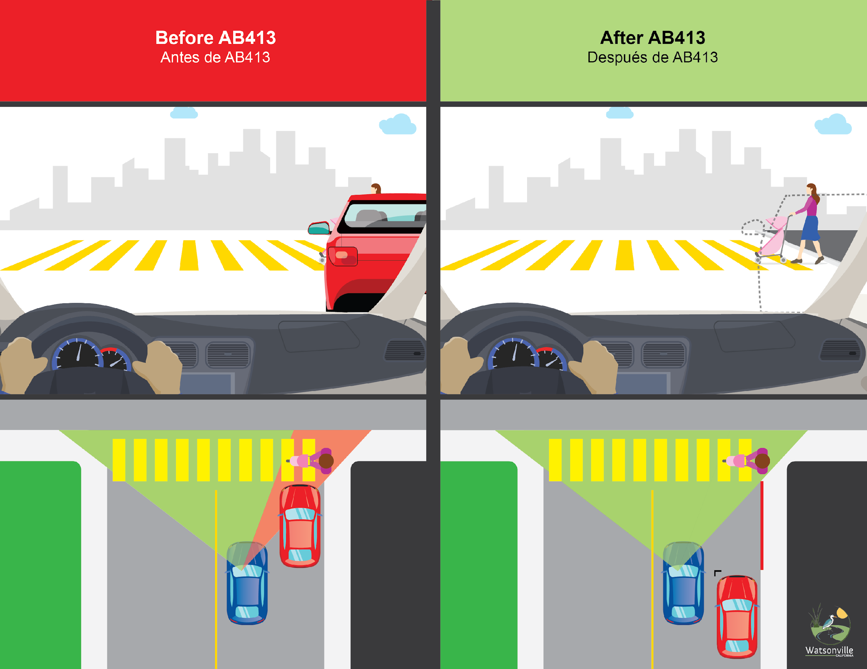
CA State Law (Parking) AB43 - Daylighting
Noticing and Enforcement
Prohibits Parking within 20-FT of
Marked or Unmarked Crosswalks
Warning Period: 6 Months
Restrictions:
- Red Curb with Crosswalk or Street Resurfacing Project

Slide 10
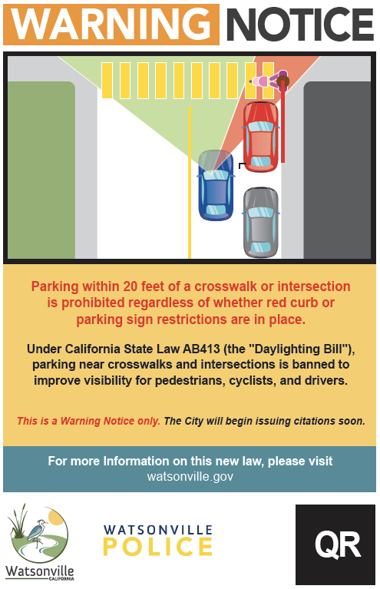
CA State Law (Parking) AB43 - Daylighting
Noticing and Enforcement
Free Download for Use by
Homeowners Associations
(HOAs)
Use by City During Warning Period
https://www.watsonville.gov/2522/Intersection-Daylighting---AB413

Slide 11


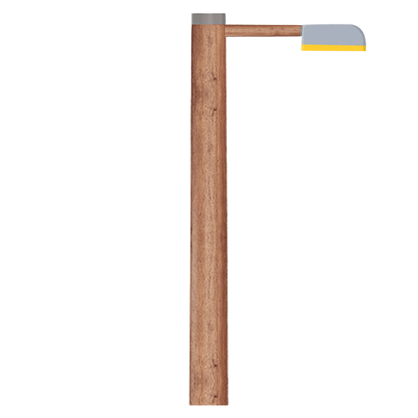
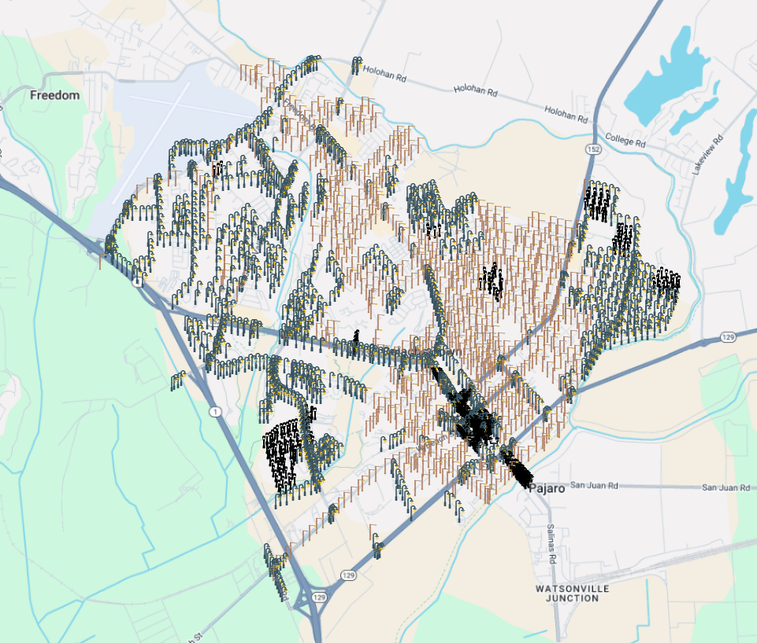
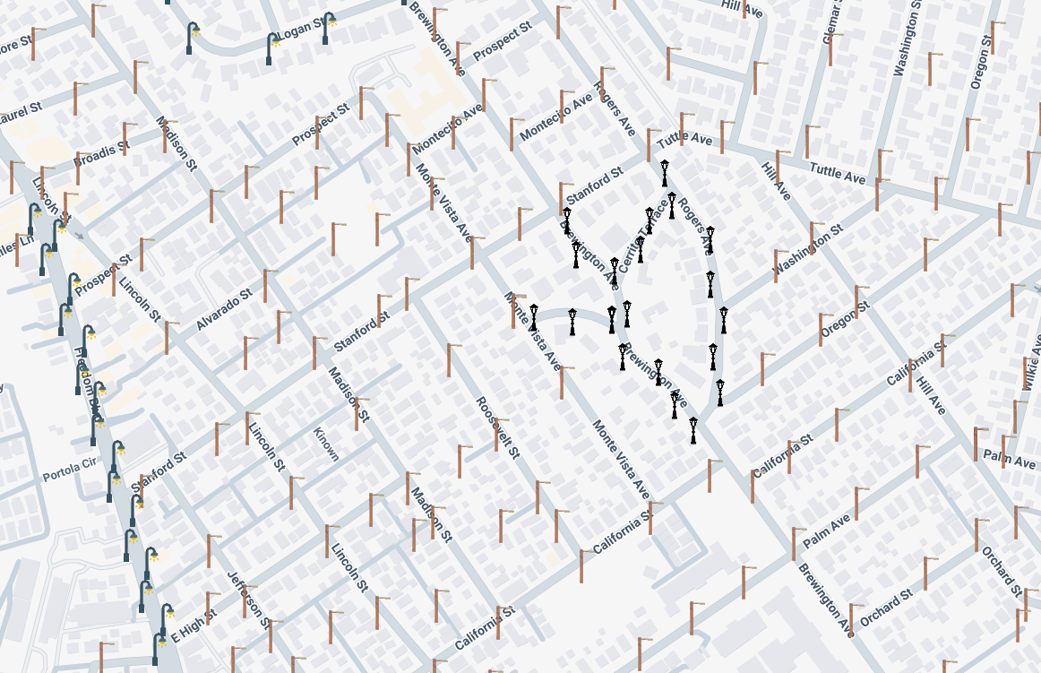
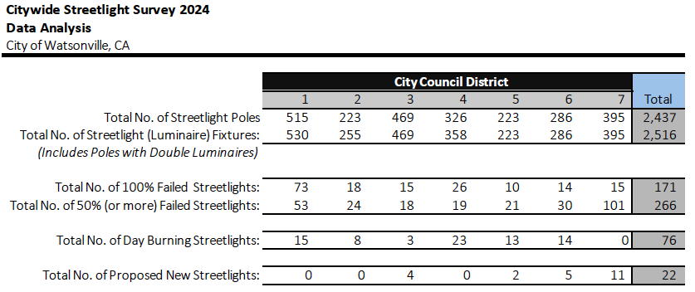
Watsonville Streetlight Study 2024
Findings
Deco Pole
City Pole
PGE Pole
Airport Blvd
Lake Ave
Stanford St
Freedom Blvd
Green Valley Rd
Main St
Freedom Blvd
Brewington Ave
Riverside Dr
Ohlone Pkwy

Slide 12
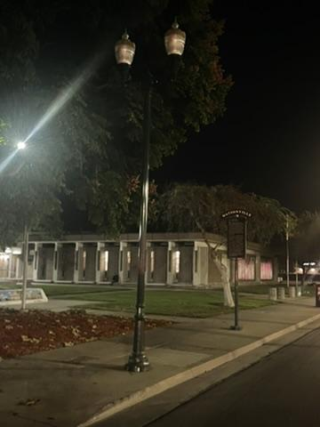
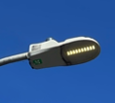
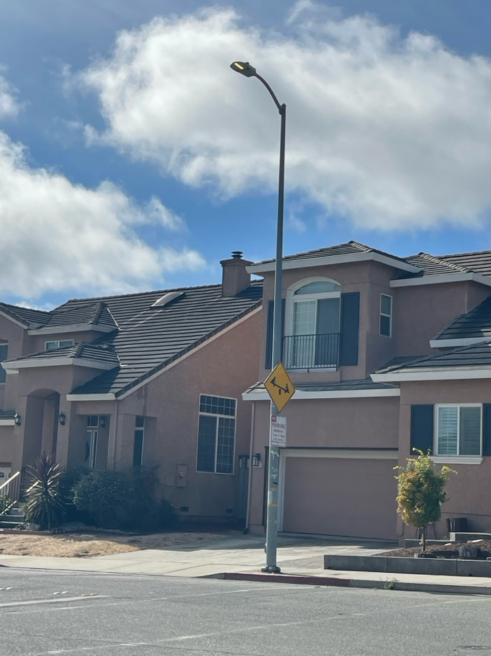
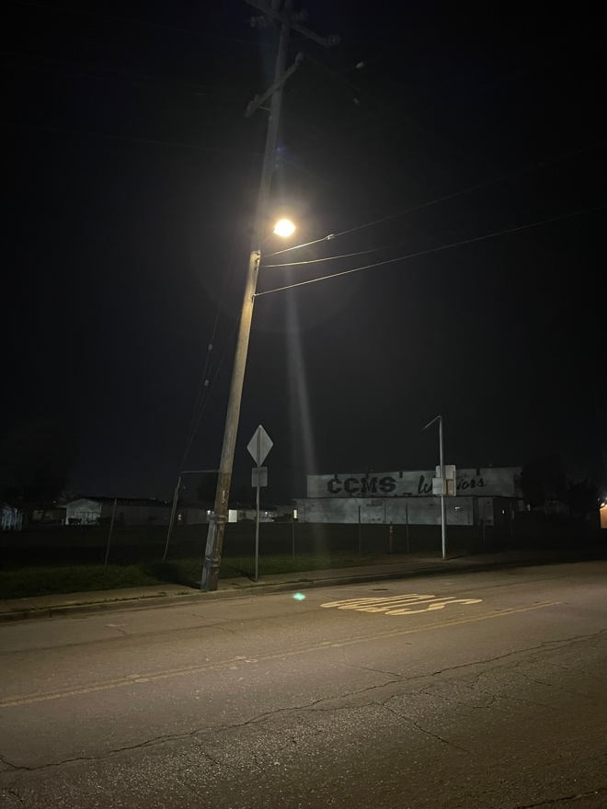
Watsonville Streetlight Study 2024
Findings
Failure
Day Burner
Next Steps:
Citywide Replacement currently in Budget Planning, $1.9 Million
Repairs to Burn-Outs for Larger Project
CREE Pilot Project

Slide 13
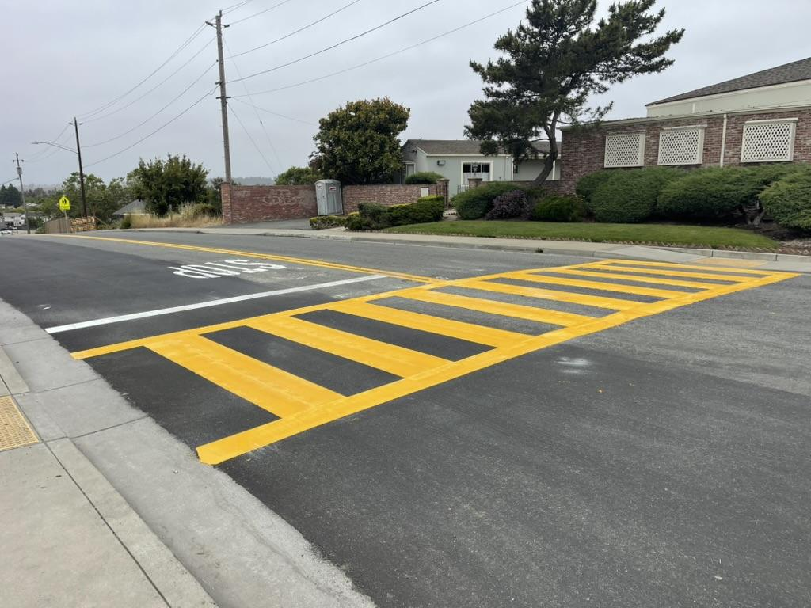
Citywide Crosswalk Enhancements
Active Projects
108 School Crosswalks
Refreshed in 2024
Hammer Dr & Arthur Rd

Slide 14
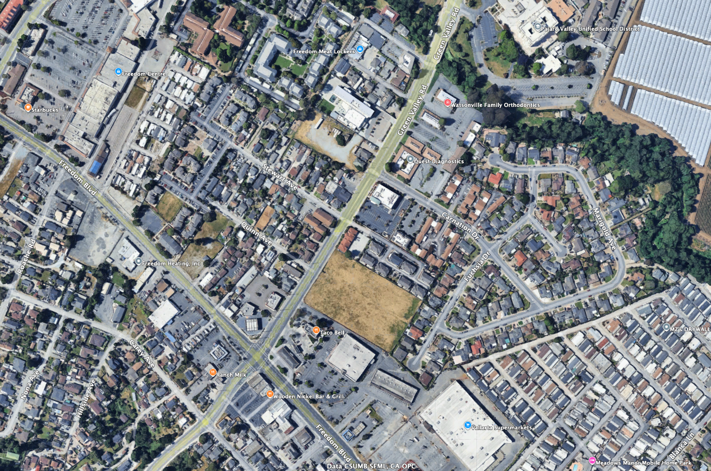


2025 CIP Transportation Projects
New Projects
Green Valley Rd Street Resurfacing
Carey Ave to East City Limits
$2.5M
Project Elements:
Street Resurfacing – Pavement Restoration
Signage & Striping
Carnation Dr
Freedom Blvd
Green Valley Rd
Carey Ave
This Photo by Unknown Author is licensed under CC BY-SA
This Photo by Unknown Author is licensed under CC BY-SA

Slide 15
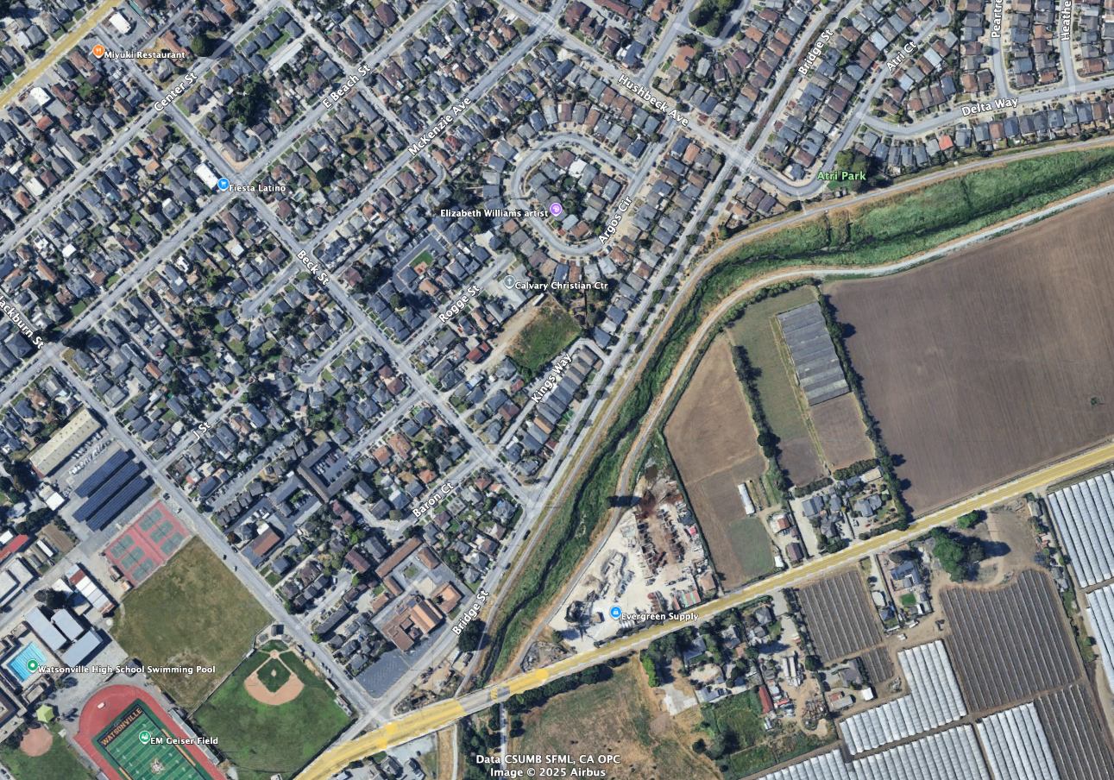
2025 CIP Transportation Projects
New Projects
Bridge Street – Utility and Pavement Improvements
Hushbeck St to Beck St
$900K
Hushbeck Ave
Project Elements:
Utility Line Reconstruction
Pavement Restoration
Beck St
Bridge St
Blackburn St
Riverside Dr (SR 129)
This Photo by Unknown Author is licensed under CC BY-SA
This Photo by Unknown Author is licensed under CC BY-SA

Slide 16
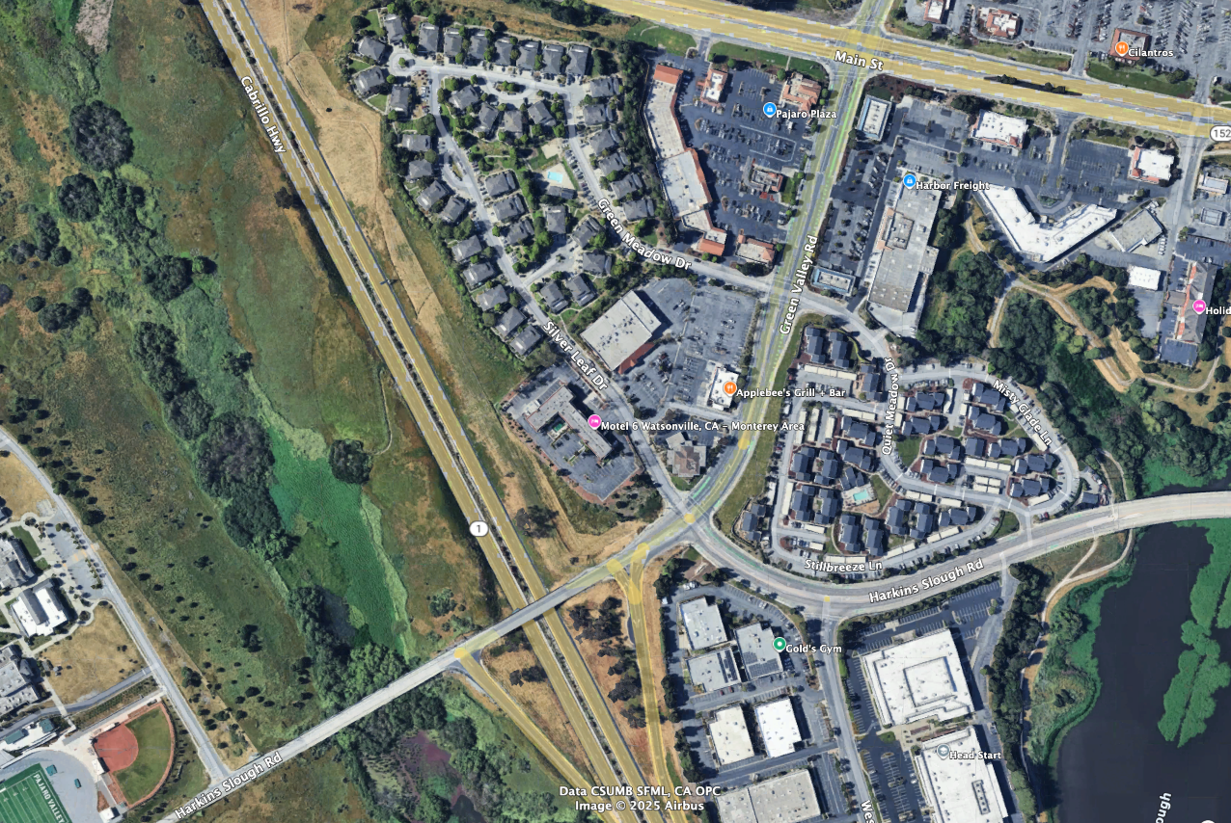
2025 CIP Transportation Projects
New Projects
Harkins Slough Rd Pedestrian Bridge at State Route 1
Harkins Slough Rd to High School
$11.0 M
Main St
Green Valley Rd
Project Elements:
Pedestrian Bridge
Safe Routes to School
Sewer Line Relocation
Highway 1
Silver Leaf Dr
Harkins Slough Rd
High
School
Green Valley Rd
This Photo by Unknown Author is licensed under CC BY-SA
This Photo by Unknown Author is licensed under CC BY-SA

Slide 17
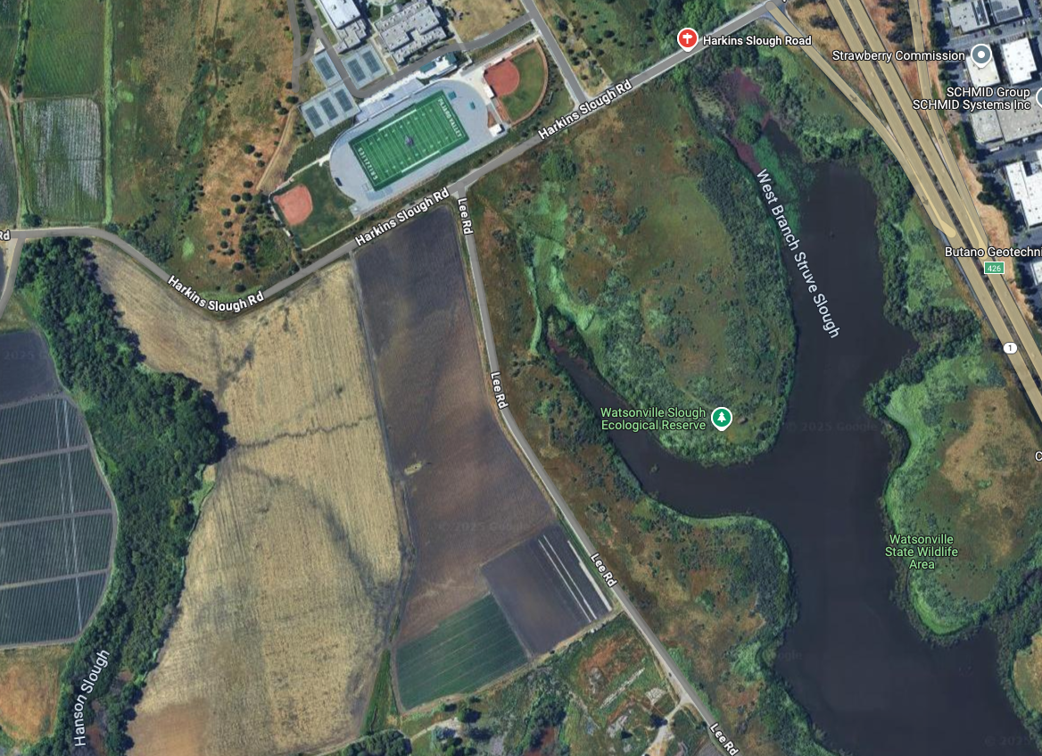
2025 CIP Transportation Projects
New Projects
Lee Rd Trail Phase 1
Location Limits
$ 1.7M
Pajaro Valley
High School
Harkins Slough Rd
Project Elements:
Sidewalk Improvements
Highway 1
Lee Rd
This Photo by Unknown Author is licensed under CC BY-SA
This Photo by Unknown Author is licensed under CC BY-SA

Slide 18
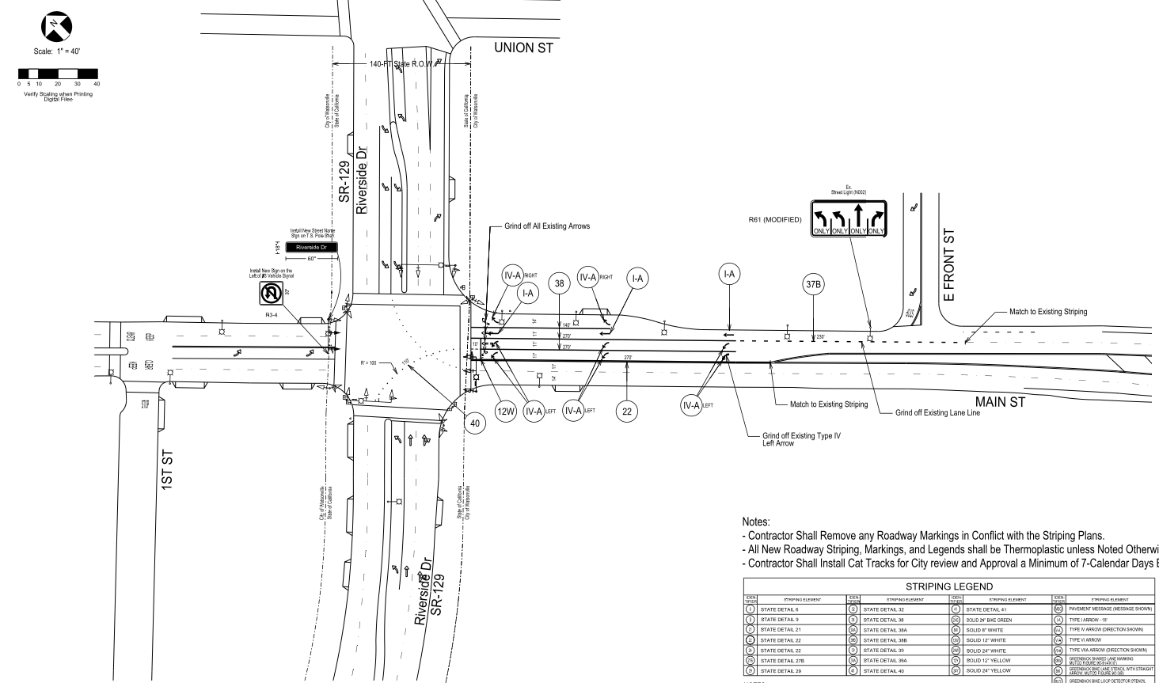
2025 CIP Transportation Projects
New Projects
Traffic Signal Modification at Main St & Riverside Dr
$100,000
Project Elements:
Add Double Northbound Left Turn Lane
Traffic Signal Modification
Signage & Striping
This Photo by Unknown Author is licensed under CC BY-SA
This Photo by Unknown Author is licensed under CC BY-SA

Slide 19
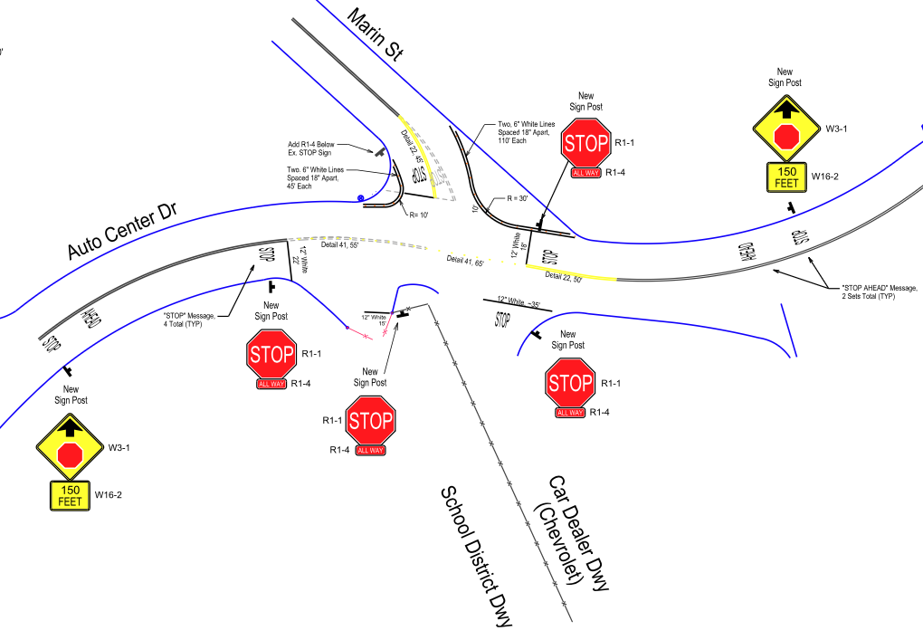
Council District 1 and 4
Ohlone Pkwy & Lighthouse Dr
Council District 2 and 5
Lincoln Ave & E 5th St (CD 2/5)
Council District 3
Holm Rd & Jeanette Wy (North)
Holm Rd & Jeanette Wy (South)
Anna St & Lawrence Ave
Council District 4 and 5
Clifford Ave & Montebello Dr (North)
Clifford Ave & Montebello Dr (South)
Clifford Ave & Melrose Ave
Clifford Ave & Evelyn Ave
Council District 5
Madison St & Palm Ave
Council District 6
Brewington Ave & Logan St
Brewington Ave & California St
Alta Vista Ave & Marilyn S6
Spring 2025 – All Way STOP Studies
13 New Studies, $30,000
Auto Center & Marin
All Way STOP
Installed October 2024
This Photo by Unknown Author is licensed under CC BY-SA
This Photo by Unknown Author is licensed under CC BY-SA

Slide 20
2025 SS4A Grant Project – Citywide Transportation Study
FHWA – Safe Streets for All
Active Transportation Plan
$400,000
-------------
(Grant) $320,000
(Local) $80,000
Citywide Transportation Survey Questionnaire
Technology Standard
Policy Recommendations
Safe Routes to School: School Map and Walk Audits
2. Local Road Safety Plan
Crash History Analysis
Develop Countermeasures with Concept Plans
3. Equity Analysis
Travel Modes
Distribution of Projects around Town
Comparison to Similar Communities

Slide 21
Questions or Topics for Future Meetings

